Slide 1
Boston Housing Data - Part A
Kothari Himanshi
M14529802

Slide 2
Background
The Boston-Housing dataset consists of information collected by U.S. Census Service concerning housing in Boston Mass Area
This data was originally published by Harrison, D. and Rubinfeld, D.L. ‘Hedonic prices and the demand for clean air’
The data consists of one dependent variable – median value of owner-occupied homes in census tract
There are total 13 independent variables

Slide 3
Data Descriptions
The dataset contains the following columns:
Crim - per capita crime rate by town.
Zn - proportion of residential land zoned for lots over 25,000 sq.ft.
Indus - proportion of non-retail business acres per town.
Chas - Charles River dummy variable (= 1 if tract bounds river; 0 otherwise).
Nox - nitrogen oxides concentration (parts per 10 million).
Rm - average number of rooms per dwelling.
Age - proportion of owner-occupied units built prior to 1940.
Dis - weighted mean of distances to five Boston employment centres.
Rad - index of accessibility to radial highways.
Tax - full-value property-tax rate per \$10,000.
Ptratio - pupil-teacher ratio by town.
Black - 1000(Bk - 0.63)^2 where Bk is the proportion of blacks by town.
Lstat - lower status of the population (percent).
Medv - median value of owner-occupied homes in \$1000s.
The Boston data frame has 506 observations and 14 attributes.
The variable medv is the target/response variable while others are independent variables

Slide 4
Basic statistics
Stats | Crim | Zn | Indus | Chas | Nox | RM | Age | Dis | Rad | Tax | Ptratio | Black | lstat | medv
Count | 506 | 506 | 506 | 506 | 506 | 506 | 506 | 506 | 506 | 506 | 506 | 506 | 506 | 506
Mean | 3.61 | 11.36 | 11.14 | 0.07 | 0.55 | 6.28 | 68.57 | 3.80 | 9.55 | 408.24 | 18.46 | 356.67 | 12.65 | 22.53
Median | 0.26 | 0.00 | 9.69 | 0.00 | 0.54 | 6.21 | 77.50 | 3.21 | 5.00 | 330.00 | 19.05 | 391.44 | 11.36 | 21.20
Std. Dev. | 8.60 | 23.32 | 6.86 | 0.25 | 0.12 | 0.70 | 28.15 | 2.11 | 8.71 | 168.54 | 2.16 | 91.29 | 7.14 | 9.20
Min | 0.01 | 0.00 | 0.46 | 0.00 | 0.39 | 3.56 | 2.90 | 1.13 | 1.00 | 187.00 | 12.60 | 0.32 | 1.73 | 5.00
25th %ile | 0.08 | 0.00 | 5.19 | 0.00 | 0.45 | 5.89 | 45.03 | 2.10 | 4.00 | 279.00 | 17.40 | 375.38 | 6.95 | 17.03
50th %ile | 0.26 | 0.00 | 9.69 | 0.00 | 0.54 | 6.21 | 77.50 | 3.21 | 5.00 | 330.00 | 19.05 | 391.44 | 11.36 | 21.20
75th %ile | 3.68 | 12.50 | 18.10 | 0.00 | 0.62 | 6.62 | 94.08 | 5.19 | 24.00 | 666.00 | 20.20 | 396.23 | 16.96 | 25.00
Max | 88.98 | 100.00 | 27.74 | 1.00 | 0.87 | 8.78 | 100.00 | 12.13 | 24.00 | 711.00 | 22.00 | 396.90 | 37.97 | 50.00
# NAs | 0 | 0 | 0 | 0 | 0 | 0 | 0 | 0 | 0 | 0 | 0 | 0 | 0 | 0

Slide 5
Basic Statistics insights
There are no null values in the data
The variables crim, zn, and dis seem to be highly right skewed distributions as the medians of these variables vary highly from mean
The attribute chas is a binary variable with values 1 and 0
The attributes age and b seem to be highly left skewed distributions
The Standard deviation and mean values of the variables medv and nox obtained from our data are different because of the units/power. However, the value (if the power is ignored) will be same. (Reference to the table given in the paper)

Slide 6
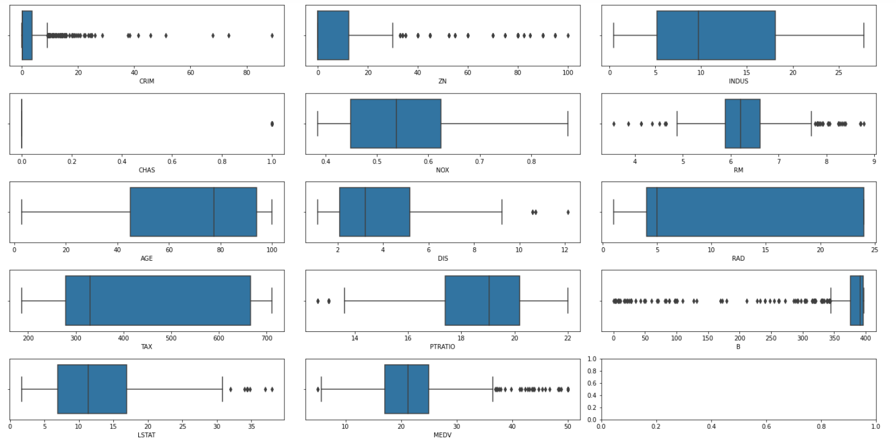
Univariate analysis – Box Plots
Univariate analysis using boxplots is used to find if there are any outliers
We can see clear outliers exist for dis, and ptratio. The best way to deal with these is to exclude those observations
There seem to be outliers for other variables lying outside of 1.5 IQR, however, they cannot be completely considered outliers. So, the observations cannot be discarded.

Slide 7
Training Data
The original dataset is split into two parts – training data and testing data – using random seed 14529802
The training dataset is 80% of original data while the test dataset is 20%
Thus, the training data consists of 404 randomly picked observations and 13 attributes

Slide 8
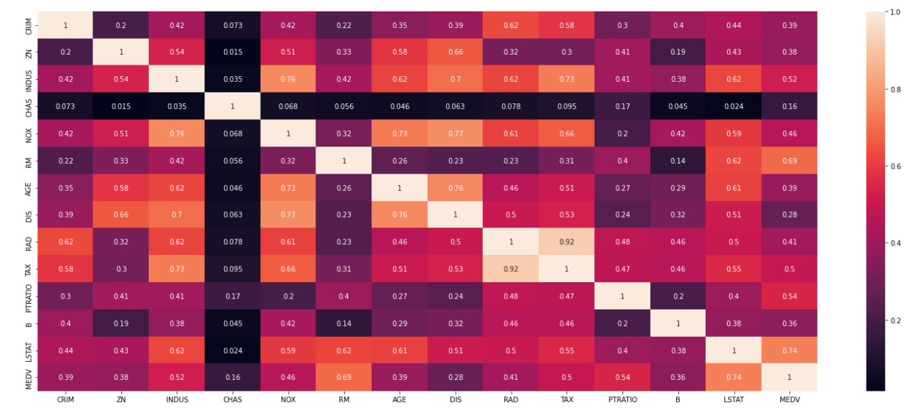
Exploratory Data Analysis – Correlation (Training Data)
The heatmap for the 80% of data (training data) shows that the dependent variable – medv – has a positive correlation with the independent variables – rm, lstat
It also shows that there is a light positive correlation of medv with tax, indus, and ptratio
Moreover, we can see that the variable lstat is correlated to other variables in the dataset which will add to multicollinearity

Slide 9
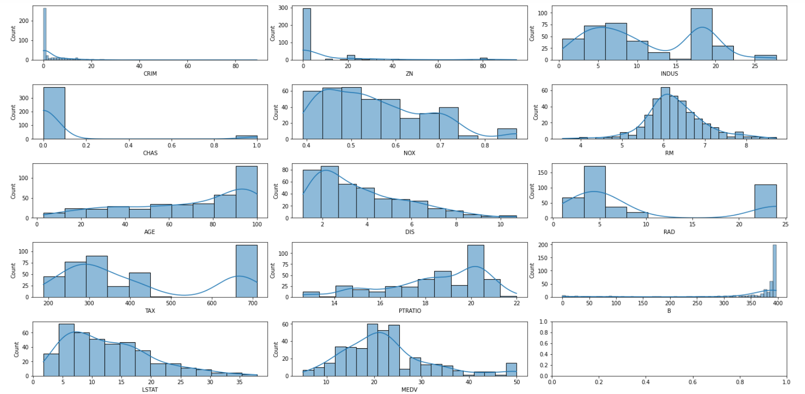
Univariate Analysis – Histograms (Training Data)
As initially expected, the variables – crim, zn, dis, and lstat - are rightly skewed
We can also observe that variables - age, and b – are left skewed
Moreover, we can see bimodal distribution for rad, indus, and tax variables
Medv, and rm seem to be near to normal distributions but are not completely normally distributed

Slide 10
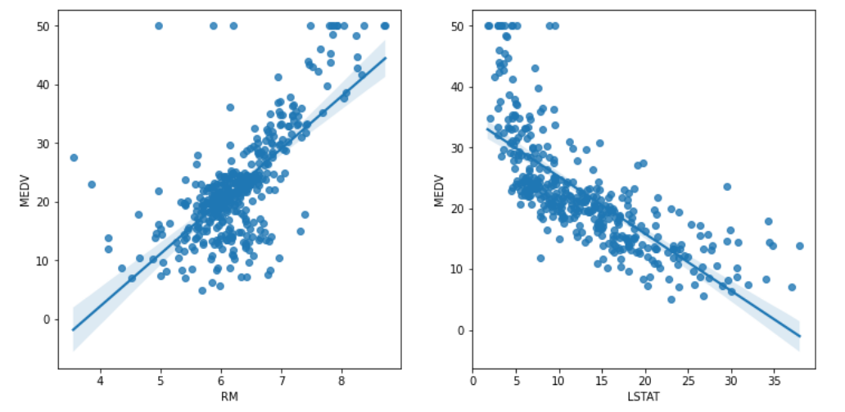
Bivariate Analysis – Scatter Plots (Training Data)
We can see through the scatterplots that there is clear linear correlation between medv and lstat variables as well as rm and medv variables
This is validated by the correlation plot seen in the earlier slide

Slide 11
Boston Housing Data - Part B
Kothari Himanshi
M14529802

Slide 12
Full model vs Null Model
Full Model:
MSE: 20.69
Null Model:
MSE: 82.82
 | Estimate | Std. Error | t value | Pr(>|t|)
(Intercept) | 32.26 | 5.68 | 5.68 | 0.00
crim | -0.10 | 0.03 | -3.05 | 0.00
zn | 0.04 | 0.01 | 2.75 | 0.01
indus | 0.00 | 0.07 | 0.03 | 0.97
chas | 3.84 | 0.97 | 3.96 | 0.00
nox | -17.54 | 4.27 | -4.11 | 0.00
rm | 4.23 | 0.49 | 8.62 | < 2e-16
age | -0.01 | 0.01 | -0.69 | 0.49
dis | -1.51 | 0.22 | -6.83 | 0.00
rad | 0.25 | 0.07 | 3.58 | 0.00
tax | -0.01 | 0.00 | -2.75 | 0.01
ptratio | -0.87 | 0.14 | -6.13 | 0.00
black | 0.01 | 0.00 | 3.42 | 0.00
lstat | -0.46 | 0.06 | -7.99 | 0.00
 | Estimate | Std. Error | t value | Pr(>|t|)
(Intercept) | 22.62 | 0.45 | 50.08 | <2e-16

Slide 13
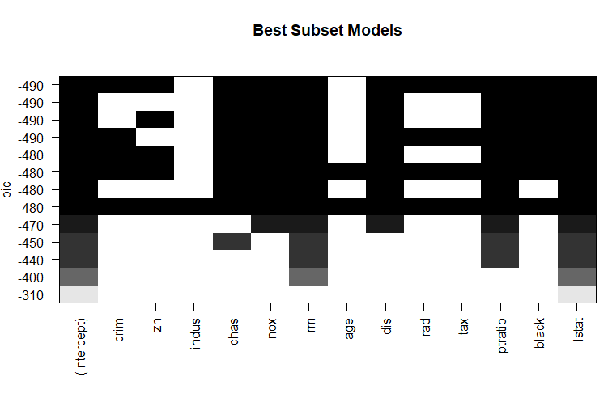
Best Subset BIC Model
Best model estimation by subset method
medv ~ crim+zn+chas+nox+rm+dis+rad+tax+ptratio+black+lstat
MSE: 20.71

Slide 14
Stepwise AIC and BIC model
Best Model by stepwise AIC –
Step 3: AIC=1245.42
MSE : 20.71
medv ~ crim + zn + chas + nox + rm + dis + rad + tax + ptratio + black + lstat
Best Model by stepwise BIC
Step 3: AIC=1293.46
MSE : 20.71
medv ~ crim + zn + chas + nox + rm + dis + rad + tax + ptratio + black + lstat

Slide 15
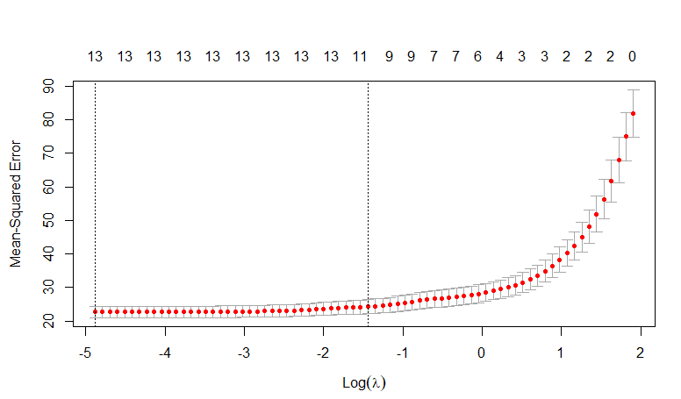
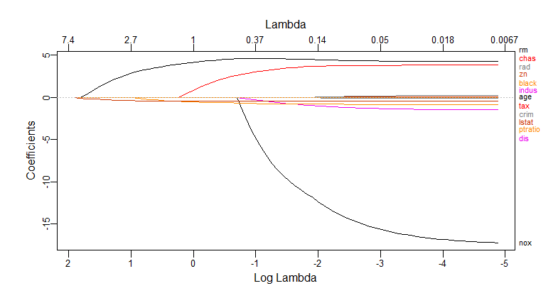
LASSO Model
Lambda.min Coefficient Table
Lambda.1se Coefficient Table
Cross Validation Plot
 | s1
(Intercept) | 3E+01
crim | -1E-01
zn | 4E-02
indus | -2E-07
chas | 4E+00
nox | -2E+01
rm | 4E+00
age | -1E-02
dis | -1E+00
rad | 2E-01
tax | -1E-02
ptratio | -9E-01
black | 1E-02
lstat | -5E-01
 | s1
(Intercept) | 18.78
crim | -0.04
zn | 0.01
indus | -0.01
chas | 3.41
nox | -9.28
rm | 4.57
age | .
dis | -0.67
rad | .
tax | 0.00
ptratio | -0.76
black | 0.01
lstat | -0.47
Log Lambda vs Coefficient plot

Slide 16
Model Evaluation
Method | Selected Variables | Model MSE (in-sample)
Null model | 1 | 82.82
Full Model | . | 20.69
Best Subset (BIC) | crim+zn+chas+nox+rm+dis+rad+tax+ptratio+black+lstat | 20.71
Stepwise (BIC) | crim+zn+chas+nox+rm+dis+rad+tax+ptratio+black+lstat | 20.71
Stepwise (AIC) | crim+zn+chas+nox+rm+dis+rad+tax+ptratio+black+lstat | 20.71
LASSO (lambda.min) | crim+zn+indus+chas+nox+rm+age+dis+rad+tax+ptratio+black+lstat | 20.69
LASSO (lambda.1se) | crim+chas+nox+rm+dis+tax+ptratio+black+lstat | 21.87
Based on the values in the table, the (in-sample) MSE is least for Full Model and LASSO (lambda.min) i.e. 20.69. Hence, based on MSE, I will be selecting a full model consisting all variables

Slide 17
Boston Housing Data - Part C
Kothari Himanshi
M14529802

Slide 18
Out of Sample Testing & Cross Validation
20% Test sample:
Out of Sample mean squared prediction (MSPE) = 29.107
Cross Validation on full data:
Lambda.min CV score = 23.08
Lambda.1se CV score = 24.39
Cross Validation score is better than MSPE of test sample. The reason for this could be the difference in the sample size which is high for CV resulting in lesser CV score while sample size for test sample is lesser and hence higher MSPE

Slide 19
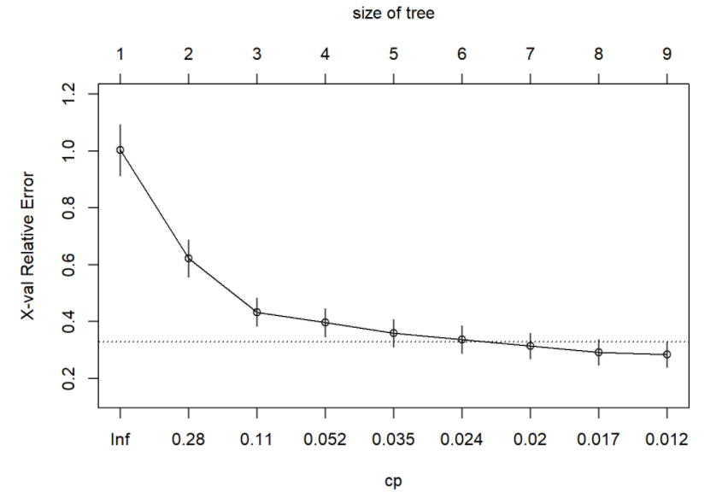
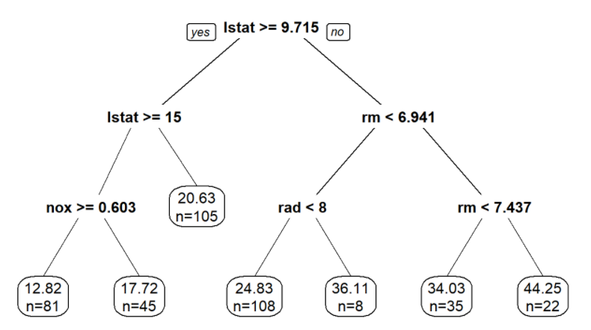
Regression Tree
Plotcp Graph
Main predictor variables – lstat, rm, nox, and rad
Consider the right most terminal node – n variable denotes the number of observations while the number on the top indicates the average of the predicted response variable
Model | Dataset | MSE/MSPE
Regression Tree | Train | 71.80
 | Test | 22.76
Linear Regression | Train | 21.87
 | Test | 29.11
Regression Tree after Pruning

Slide 20
Full Data & Summary
Regression Tree
ASE = 83.03
Best Model – LASSO (Lambda.min)
ASE = 22.03
Random Seed ​ (80%/20%)​ | Method | Average Sum Squared Error ASE​ (in-sample)​ | MSPE (out-of-sample)​ | 5-fold CV​​
14529802​ | Linear | 20.69​ | 29.11​ | -​
 | Regression Tree | 71.80 | 22.76 | -
Full data​ | Linear | 22.03​ | -​ | 23.08​
 | Regression Tree | 83.03 | - | -

Slide 21
Thank You!

